Slide 1



Slide 2


While the Niagara 4 platform offers powerful potential, we saw an opportunity to make it more accessible and easier to use.
Advanced Logic Modules enhance the Niagara 4 platform, providing intuitive controls that empower system integrators and building professionals, helping to better optimise efficiency and performance.
2

Slide 3

Seamless integration with Niagara4
Simplify workflows for building management
02
03
Extend Niagara4 capabilities
Continuous improvement via regular updates
01
04
3

Slide 4

Extend functionality, maintain familiarity." Customisation for Unique Needs:
"Every building is unique. Our flexible, customisable modules adapt to specific BEMS requirements, providing tailored solutions for optimal performance across various building sizes and types."
Seamless Integration, Enhanced Capabilities:
"Free bird's modules integrate smoothly with Niagara4, enhancing its capabilities without disrupting existing workflows.
Empower Your Team:
"Reduce training time and boost productivity. Free bird's intuitive modules make advanced BEMS accessible to your entire team, fostering collaboration and driving innovation in building management."
4

Slide 5
Leverage Trend skills in Niagara 4
Seamless Trend to Niagara 4 Transition: “Advanced Logic bridges the gap between Trend and Niagara 4, allowing you to leverage existing skills while unlocking the advanced open source capabilities of the Niagara4 platform.
System Houses
Estate Managers
01
02
Recreate your Trend Macro Library in Niagara4
Find Familiar Trend Logic in Niagara Devices
5

Slide 6

Familiar Modules for Complex Logic
“Smooth transition and enhanced performance.“
Empowering System Integrators: TTC’s, SI’s and MSI’s managing complex BEMS projects…
… our Advanced Logic Modules streamline workflows, reduce project time, and enhance service offerings cutting time on corrective engineering.
6

Slide 7
Familiar doings
“Deliver excellence, effortlessly."
Intuitive Control for Complex Systems: "Experience the power of simplicity”.
Our user-friendly interfaces reintroduces familiar workflow:
Make advanced BEMS logic accessible to all skill levels.
Knobs
Sensors
Switches
Function Modules
Logic Modules
Driver Modules
7

Slide 8

Business Standard : Industry Standard
“Complexity, simplified."
Standardisation Across Projects:
"Create consistency across your BEMS portfolio. Freebird's modules enable standardised software, ensuring a simplified transition and uniform performance and operation between Trend and Niagara4, thus allowing for easier management across diverse projects."
8

Slide 9
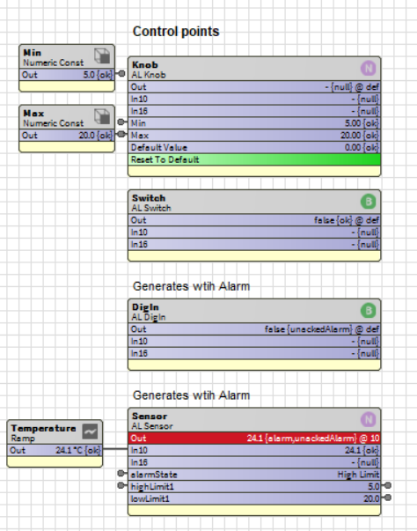
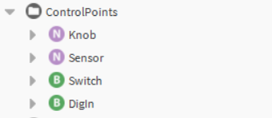
9

Slide 10

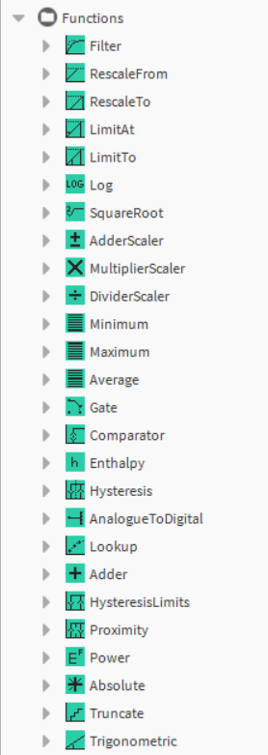
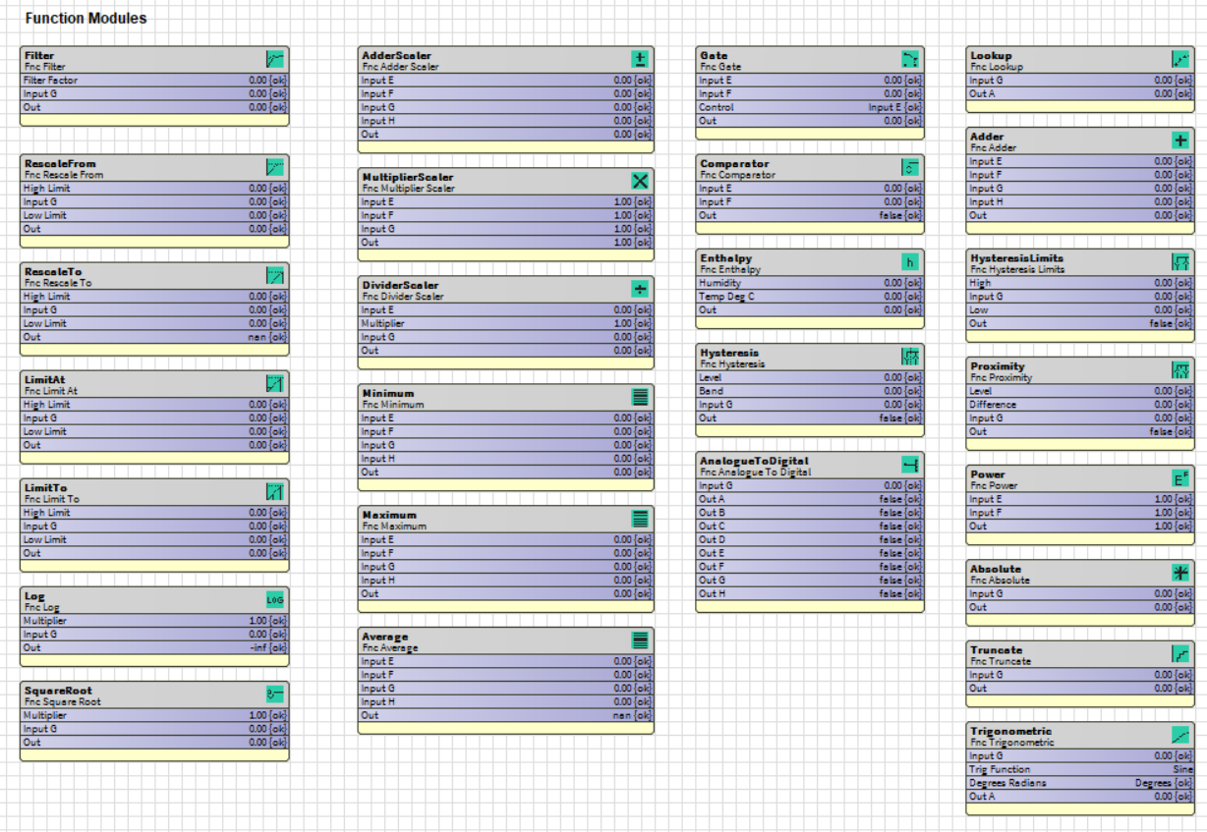
10

Slide 11
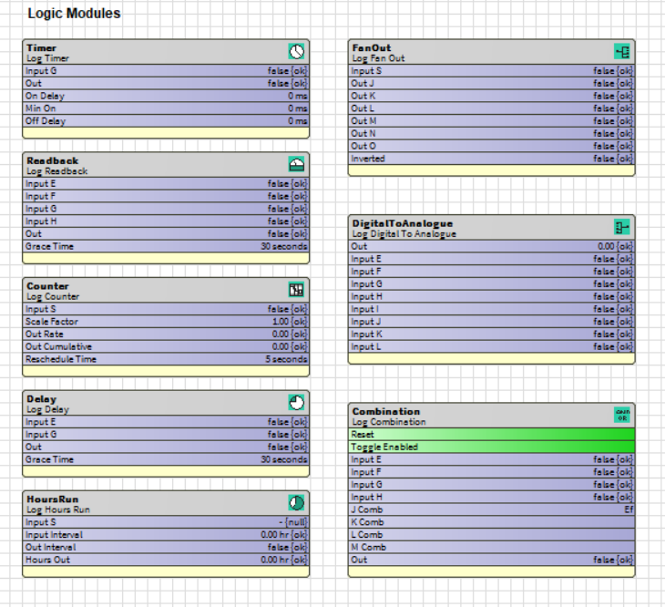
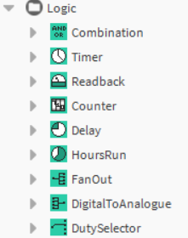
11

Slide 12
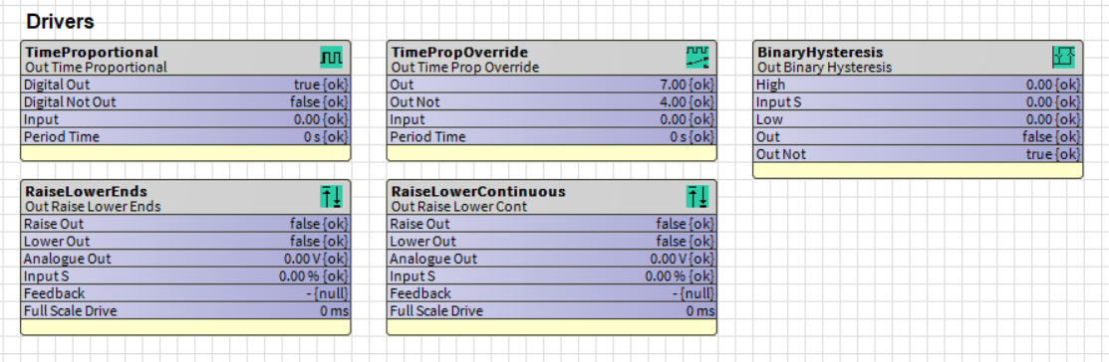
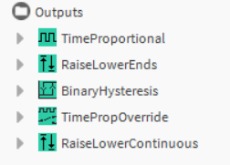
12

